Slide 1
The Economic drivers for regional Waste Management collaboration
Mike Ritchie and Associates (MRA)

Slide 2
Trends in Waste

Slide 3
Current System
43 MT
C+D Recycling 9 MT
C+I 8 MT
Kerbside 5 MT
AWT 1 MT
20 MT Landfill

Slide 4
2020
System
80 MT
C+D Recycling 22 MT
C+I 23 MT
Kerbside 6 MT
AWT 9 MT
20 MT Landfill

Slide 5
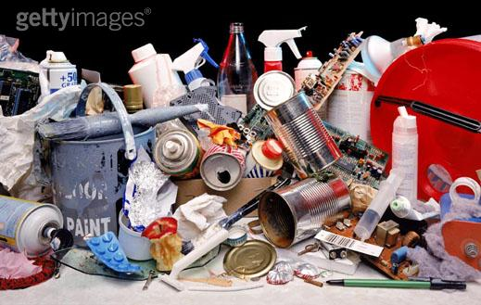

Organic Waste vs. Other Wastes
10.5 MT
1.3 MT
Organics
22 MT Waste
Plastic bags
Tyres
Computers
Printer Cartridges
TV
CDL
Household paint
Oil
Cigarette butts
Methane
Climate change

Slide 6
Targets
State | Year | MSW | C&I | C&D
NSW | 2022 | 70% | 70% | 80%
VIC | 2013 | 65% | 80% | 80%
WA | 2015 | 50% (Metro) 30% (Other) | 55% | 60%
ACT | 2015 | Over 80%
SA | 2015 | 70% | 75% | 90%
QLD | 2020 | 65% (23% now) | 60% (18% now) | 75% (35% now)
NT | No target
TAS | In development

Slide 7
Focus on the Right Waste Streams
Plastic bags: 20,700t
(3.92 billion bags)
22 MT
CDL: 600,000 t
(16 billion containers)
Organics
+
Textiles
Plastic
Stones
etc.
Tyres 280,000t
TV: 15,000t
Paint: 77,400t
Computers: 25,000t
Oil: 93,000t
Cigarette butts: 15,000t
Printer Cartridges: 5000t
18.7 MT
Landfill
Notes:
critically review myths (plastic bag) and decide on priority streams based on bang for $ (s 46-47)

Slide 8
Local Government Must Focus on the Right Materials for Recycling
Cigarette butts
$
Cost per tonne
Plastic bags
Public place
CD’s
Kerbside containers
Returned food
mattresses
E waste
textiles
C+I MRF material
C+D MRF material
Glass
batteries
ORGANICS AWT
Fluoro tubes
Diversion rate from landfill
cardboard
metals

Slide 9
Comparative Landfill Levies

Slide 10
Comparative Landfill gate fees

Slide 11

  WLRM Grant Funding
Grant | Funding up to | 2014 funding rounds
Organics collection systems (councils) | $1.3 m | February October
Community recycling centres | $250 k | February August
Resource recovery facility expansion | $1 m | February
Illegal dumping: clean-up and prevention | $150k | February
Love Food Hate Waste | $70k | February November
Organics infrastructure | $5 m | March
Major resource recovery infrastructure | $1 m | March
Litter | $ EOI | April

Slide 12
All options are compared to a base case (the Opportunity Cost). If the base case is cheap, options are limited
OR
Processing
Landfill
$189/t
$190 / t

Slide 13
All options are compared to a base case (the Opportunity Cost). If the base case is cheap, options are limited
OR
Processing
Landfill
$189/t
$80 / t
Most processing of mixed waste will be uneconomic based on existing landfill gate fees (except for Armidale landfill)

Slide 14
Opportunity cost of landfill – most rural landfills do not include full costs

Slide 15
Landfill – Full life calculator
Post closure remediation
Post closure Monitoring
Asset replacement
Depreciation
Landfill gas

Slide 16
Understanding the opportunity cost
Council 2
LF = $190
Council 3
LF = $60
Council 1
LF = $90/t
$10/t
$30/t
Bio Hub
Plus transport $30/t
Some minor streams
Opportunity cost of landfill = average local disposal cost (MSW $90/t) + transport tonnes ($20-30/t) x total tonnage

Slide 17
Generic model of processing
P+C 20%
Plastic 4%
100%
Processing
100% x ($100)
Oil 1%
Gate Fee
Timber 20%
Steel 4%
$120/t
Aluminium 1%
< 50% or else?
Mixed rubble
Glass fines
Composites
Textiles
etc
$190 / t

Slide 18
Commodity Values
Waste Stream | Cost per tonne ($/t)
Aluminium | $1500
Cardboard | $140
Mixed paper | $150
Glass (sorted) | $72
Steel | $120
PET | $300
PP | $350
HDPE | $300
Polystyrene | $600
Compost | $20
Bio Char | $?
Lead Acid Batteries | $700
Electricity | $0
Timber | $-15
Low grade compost | $-15
E-Waste | $0
Mattresses | $-25 per mattress
Oil, paint, drums, tyres, fluorescent tubes, gas bottles | $0 (until 2017)

Slide 19
$100-180/t
$0/t
$100/t
$200/t
?
?
$200/t
$?

Slide 20
Technology Options
OPTIONS
Biological
/ mechanical
Thermal
Landfill
Composting
Anaerobic
Digestion
Incineration
Pyrolysis
Gasification
700
10 MBT
100 Organics
5
Only
medical waste
0
0
Technology Risk
Increasing gate fee

Slide 21
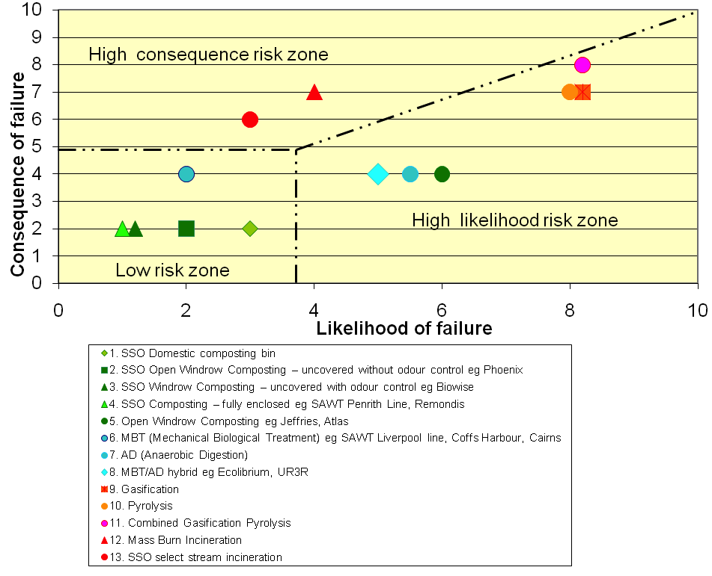
Technology Risk

Slide 22



First Council decision - Household Bins?
94% households have garbage bin
90% have recycling bin
Only 50% households have a green bin
But < 2% put food in it
Notes:
Problematic streams such as nappies.

Slide 23
FOGO and 360
Composting of organic waste?
~23%
~ 65%
Notes:
Problematic streams such as nappies.

Slide 24
A view from afar:
Armidale needs some landfill life
  Large Bioreactor will become a vacuum cleaner
Armidale needs parts of BIOHUB that are economically feasible today
  composting, C+I /C+D sorting, Pyrolysis?
The economics unclear to me
Model the options before any decision – incl landfill costs

Slide 25
MRA Consulting
Mike
mike@mraconsulting.com.au

Slide 26

Organics Carbon and the CPRS
Why we need an Organics Revolution in Australia
Mike Ritchie
12 Nov 2009
Markets for Organics
There is an UNLIMITED market for organics - the only question is the price
Compost is a push market NOT a pull market
Price it to give it away?
=$9/t
gate fee
premium here
=$10/m3 sale price here
Notes:
26

Slide 27
Organics Carbon and the CPRS
Why we need an Organics Revolution in Australia
Mike Ritchie
12 Nov 2009
Buffers
Are the key to technology selection and local government choice
NSW
  < 500m fully enclosed
  500-2000 enclosed receival
  >2000m open air
VIC (source Blue Env’t)
t/yr | Static pile | Open windrow | Continuous aeration | Enclosed | In-vessel
365 | 1500 m | 1000 | 500 | 250 | 200
3,650 | 2000 | 1500 | 1000 | 500 | 200
36,500 | 2500 | 2000 | 1500 | 1000 | 500
Notes:
27

Slide 28
State Government Policies
Waste Less, Recycle More WLRM)
  -$465.7 m funding
  - 4 years
Statutory review of the Waste Regulations
New Energy from Waste policy
EPA requirements for a regional approach to waste management

Slide 29
Energy from Waste policies – VIC NSW WA
Waste types
EFW Draft Policy Statement out for consultation
Ensures EFW:
achieves minimal risk of harm to the environment and human health; and
does not undermine higher order waste management options (such as avoidance, re-use, recycling)
biomass from agriculture
uncontaminated wood waste
recovered waste oil and tallow
waste from virgin paper pulp activities
landfill and biogas and;
coal washing rejects
http://www.environment.nsw.gov.au/waste/wasteless.htm

Slide 30
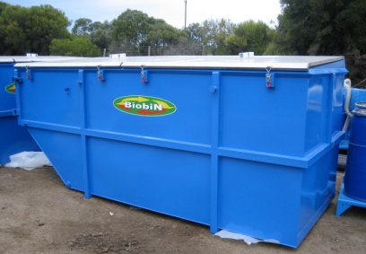
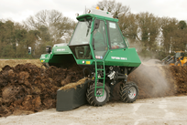
Processing Options
Biobin
Groundswell
Open Windrow
MAF
Gore
Biodegma
Shepparton cover
Biowise static pile
Remondis tunnels
Biomass tunnels
SAWT tunnels
Hot Rot
Biocell
Others including AD (which doesn’t work on FOGO or waste)

Slide 31
Operating Pyrolysis Facilities
(Partial list)
Location | Company- Technology | Began Operation | Feedstock | Capacity | Syngas/ Waste heat utilisation
Toyohasni City, Japan | Mitsui R-21 | 2002 | MSW | 400 t/d | 8.7 MW Power
Hamm, Germany | Techtrade | 2002 | MSW, Sewage Sludge | 353 t/d | Power Generation
Koga Seibu, Japan | Mitsui R-21 | 2003 | MSW | 260 t/d | 4.5 MW Power
Yarne Seibu, Japan | Mitsui R-21 | 2000 | MSW | 220 t/d | 2.0 MW Power
Nishiiburi, Japan | Mitsui R-21 | 2003 | MSW | 210 t/d | 2.0 MW Power
Izumo, Japan | Thide Environment | 2003 | MSW, Industiral & Sludge | 190 t/d | Power Generation
Kyoboku Regional, Japan | Mitsui R-21 | 2003 | MSW | 60 t/d | 1.5 MW Power
Burgau, Germany | Technip/Waste Gen | 1988 | MSW, Sewage Sludge | 54 t/d | Power Generation
Ebetsu City, Japan | Mitsui R-21 | 2002 | MSW | 40 t/d | 2.0 MW Power
Arras, France | Thide Environment | 2004 | Household Wastes | 100 t/d | Industrial Stearn
Singapore | Entech Renewable Ene | 1997 | Food Processing Wastes | 72 t/d | 4.0 MWt (as Steam)
Korea | Entech Renewable Ene | 2006 | MSW | 60 t/d | Power Generation
Hong Kong | Entech Renewable Ene | 1990 | MSW | 58 t/d | Power Generation
Notes:
In 2003 Eco-Valley became one of the first waste-to- energy facilities in the world to utilize Plasma Gasification technology on a commercial basis. Eco-Valley is located in Japan and has been successfully processing MSW with plasma for over seven years.
The facility processes up to 220 tonnes-per day of MSW or up to 165 tonnes per day of a 50/50 mixture of MSW and auto shredder residue. The technology used at Eco-Valley is a result of a successful collaboration between Westinghouse Plasma Corp. and Hitachi Metals.

Slide 32
Operating Pyrolysis Facilities
Location | Company- Technology | Began Operation | Feedstock | Capacity | Syngas/ Waste heat utilisation
Aalen, Germany (Pyrolisis/Gasification plant) | PKA | 2001 | MSW | 70 t/d | SNG as energy source
Genting/Sri Layang, Malaysia | Entech Renewable Ene | 1998 | MSW (WDF) | 60 t/d | 6.9 MWt
P.N.G. | Entech Renewable Ene | 2003 | MSW | 40 t/d | Power Generation
Romoland, California, USA | IES | 2007 | MSW | 40 t/d | SNG as energy source
Chung Gung Municipality, Taiwan | Entech Renewable Ene | 1991 | MSW | 30 t/d | 2.3 MWt (Steam)
Korea | Entech Renewable Ene | 2003 | MSW | 30 t/d | Power Generatio
Bristol, United Kingdom (Pyrolisis/Gasification plant) | Compact Power | 2002 | Clinical & Special Waste | 24 t/d | Heat for Autoclav
Australia | Entech Renewable Ene | 1996 | MSW (WDF) | 15 t/d | Power Generation
Indonesia | Entech Renewable Ene | 1998 | MSW (WDF) | 15 t/d | Power Generation
Chung Gung Municipality, Taiwan | Entech Renewable Ene | 1992 | MSW (WDF) | 15 t/d | 2.3 MWt (Steam)
Poland | Entech Renewable Ene | 2004 | Biohazardous Waste (WDF) | 3.5 t/d | 5.6 MWt
Scinopharm Corporation, Taiwan | Entech Renewable Ene | 2002 | Pharmaceutical Prod. Waste | 15 t/d | 3.5 MWt
Poland | Entech Renewable Ene | 2004 | Biohazardous Waste (WDF) | 3.5 t/d | 5.6 MWt
Notes:
In 2003 Eco-Valley became one of the first waste-to- energy facilities in the world to utilize Plasma Gasification technology on a commercial basis. Eco-Valley is located in Japan and has been successfully processing MSW with plasma for over seven years.
The facility processes up to 220 tonnes-per day of MSW or up to 165 tonnes per day of a 50/50 mixture of MSW and auto shredder residue. The technology used at Eco-Valley is a result of a successful collaboration between Westinghouse Plasma Corp. and Hitachi Metals.

Slide 33
Gasification / Pyrolysis - Key issues / risks
Benefits:
Capable of being integrated with other processes such as output from MBT / PEF production;
Can often be developed progressively on a modular basis;
Small scale units can potentially be integrated into community CHP;
Their smaller scale makes them compliant with the proximity principle, and this can help in public perception and in gaining planning permission.
Key issues / risks:
Often requires pre-processed fuel of consistent quality;
Many technologies yet to be fully proven at a commercial scale for MSW (‘bankability’ issues);
May suffer form the same negative perception as incineration;
Often more expensive (gate fee) than conventional incineration;
Proponents suggest technologies are more energy efficient, however this has not been proven to date.
SLR Report

Slide 34

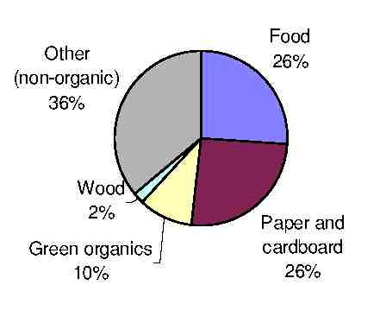
Organics in Household Waste
Approx. 66%

Slide 35
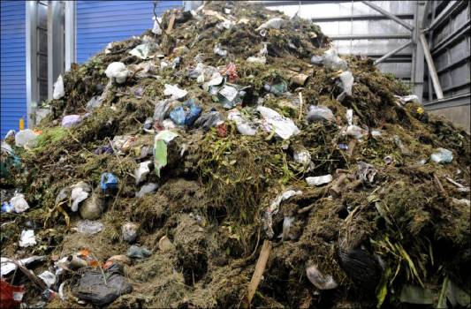
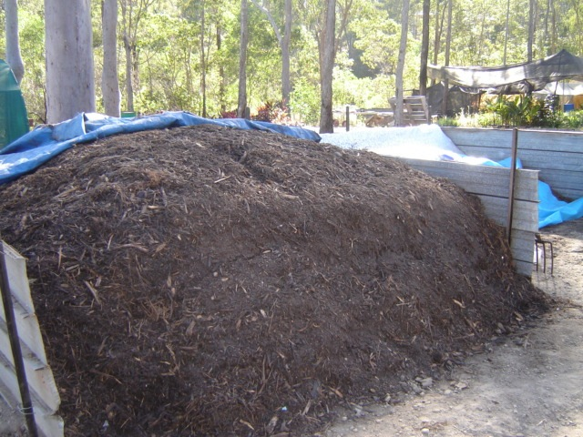
Divert organics to composting
This…
To this

Slide 36
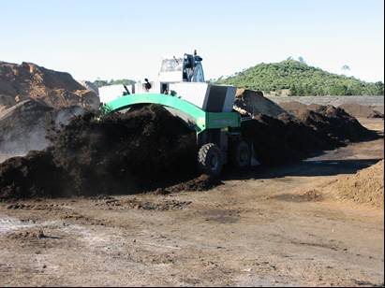
Composting - Windrow and Source Separated Organics
Dulverton Waste Management
Windrow; 20,000 t/yr
$2mill; $60/t

Slide 37
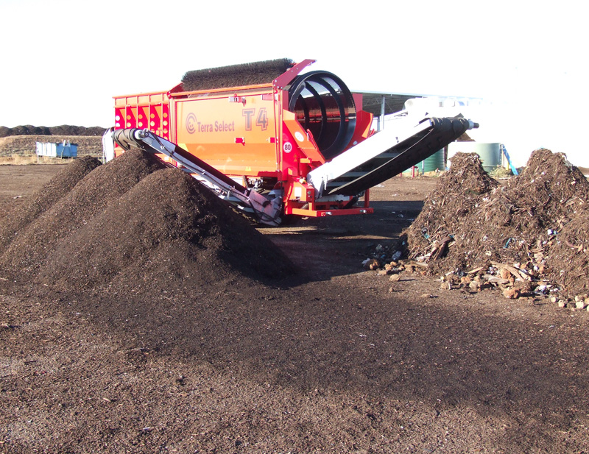

Slide 38

Composting - Windrow and Source Separated Organics

Slide 39
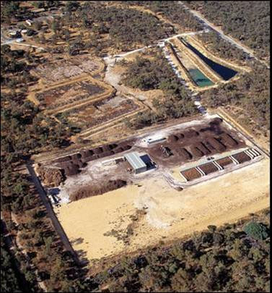
Static Pile Composting: $10 million

Slide 40
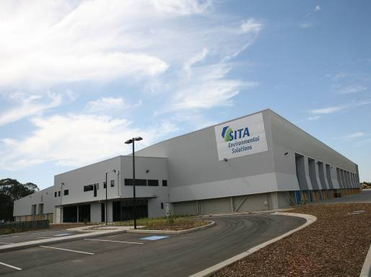
MBT - SAWT – Elizabeth Drive: $50 million
60% recovery

Slide 41
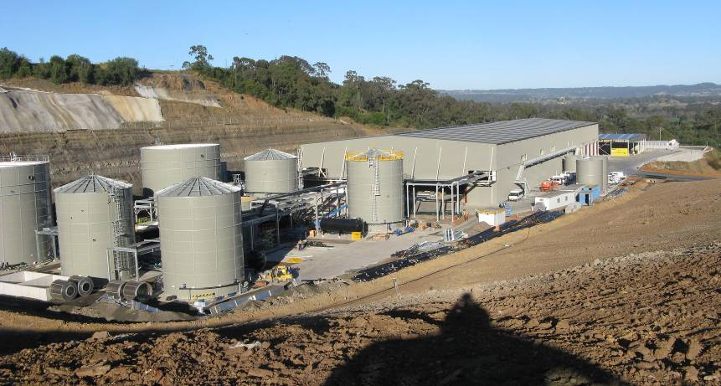
Anaerobic Digestion - WSN – Arrow Bio
$40 million: 60% recovery, energy

Slide 42
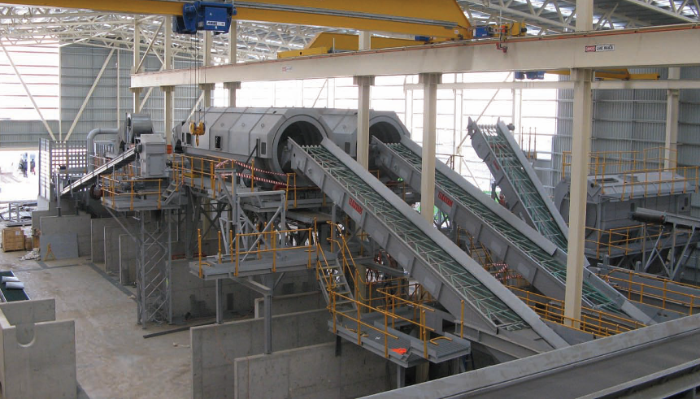
WSN – ArrowBio

Slide 43
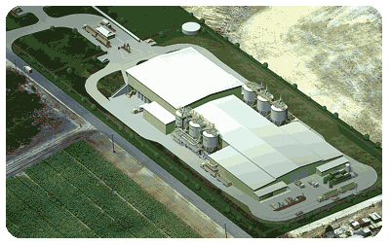
Anaerobic Digestion. AnaeCo $20 million, energy

Slide 44
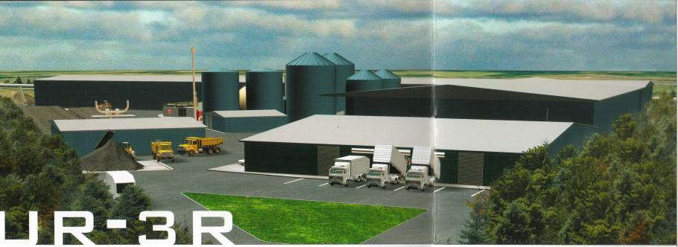
Anaerobic Digestion GRL $75 million:
60% diversion, energy

Slide 45
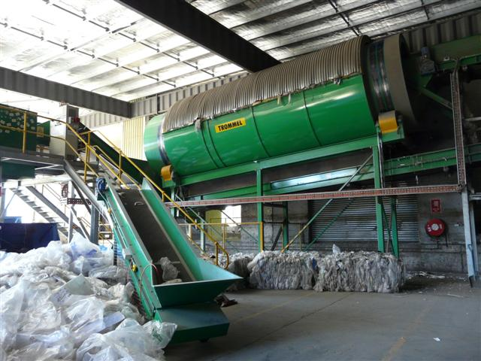
C+I sorting plants

