Slide 1
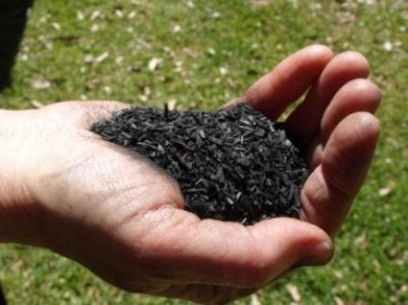

The Case for Biochar
Annette Cowie, Bhupinderpal Singh
Lukas Van Zwieten

Slide 2

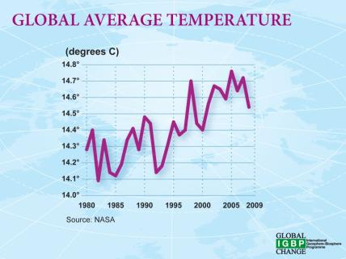
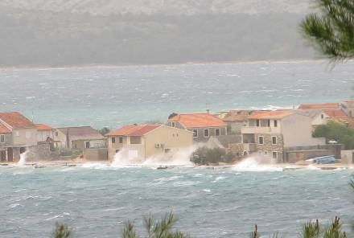
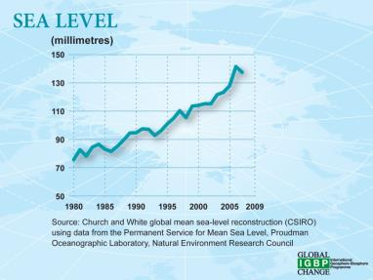
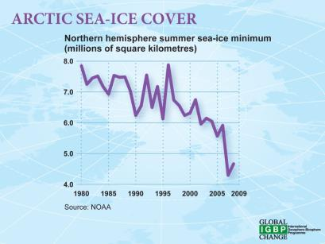
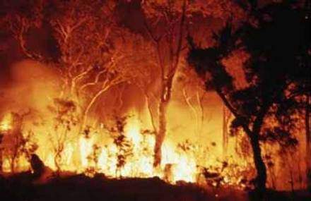
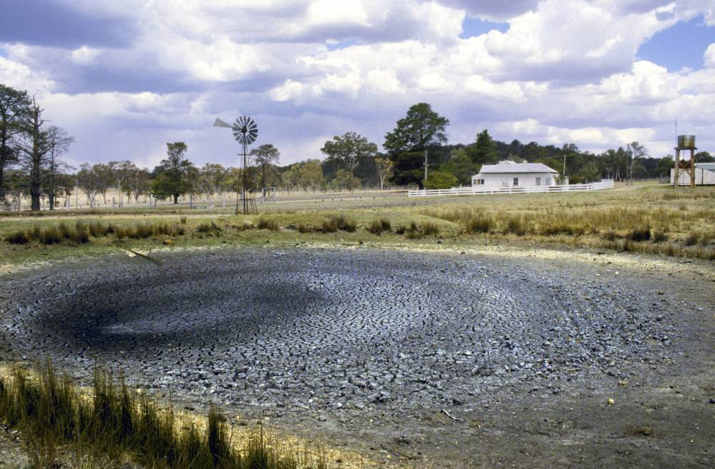

Slide 3
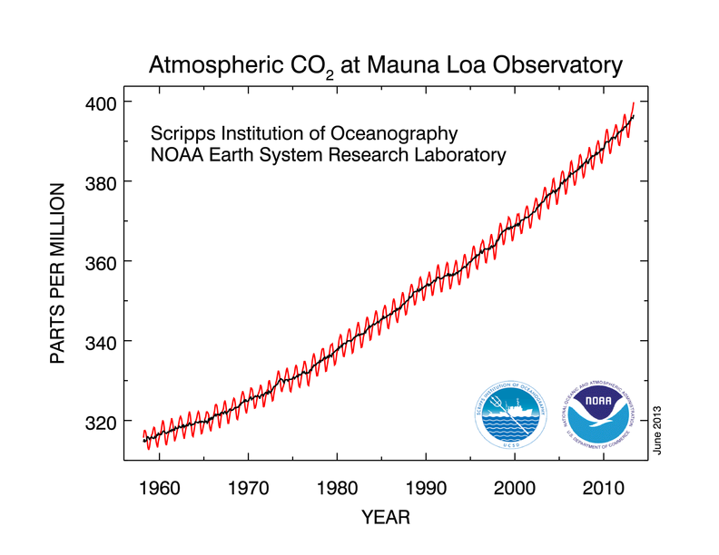

Slide 4

Costs of climate change
In 2010, climate change cost:
700 billion USD
  0.9% global GDP
400,000 deaths per year –
90% children
Climate change + Carbon economy
  costs 1.2 trillion USD
  kills 4.975 million
DARA, 2012
Notes:
Kills: Mostly from malnutrition and communicable disease
Costs: lost productivity, extreme events,
Carbon economy:
Costs:
kills: indoor smoke, air pollution, occupational hazards

Slide 5
Too late to avoid 2° C ?
2° C: target of the Copenhagen Accord to avoid catastrophic outcomes
Already increased by 1 degree
At least 0.5 degree unavoidable
Without immediate and drastic action we cannot meet the 2° C target
GEA, IPCC AR5: relying on BECCS to provide “negative emissions”

Slide 6
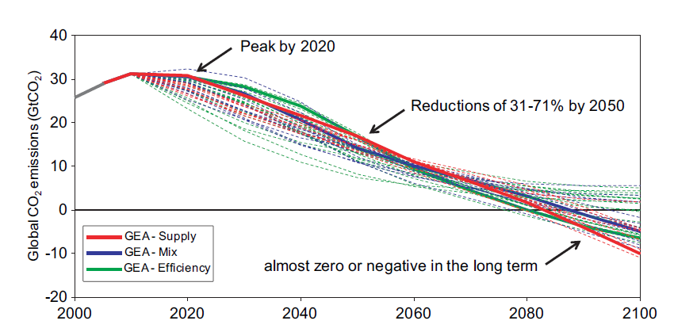
Global Energy Assessment 2012

Slide 7
Negative emissions options
Afforestation, soil carbon management
Enhanced weathering
Direct air capture
Ocean fertilisation
“BECCS” –
Bioenergy+ Carbon Capture &Storage

Slide 8
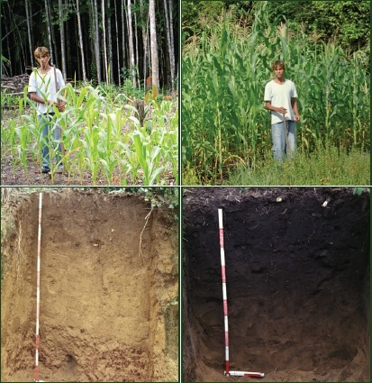
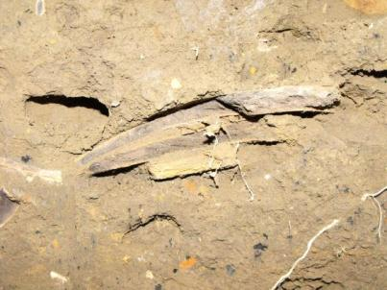
Amazonian Terra preta
Terra preta (dark earth) soils
  High plant productivity
  High organic carbon
  – stable char (black carbon)
Source: www.biochar-international.org

Slide 10
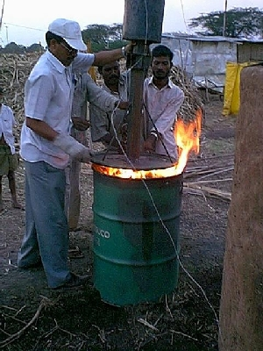
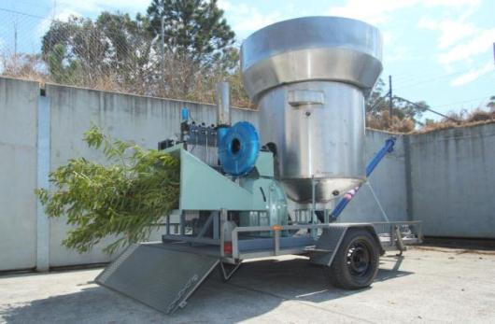
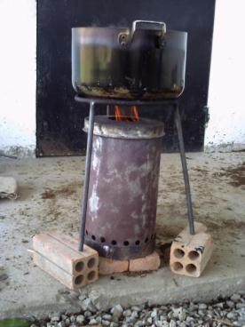

Slide 11
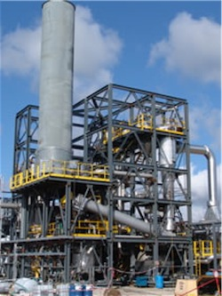
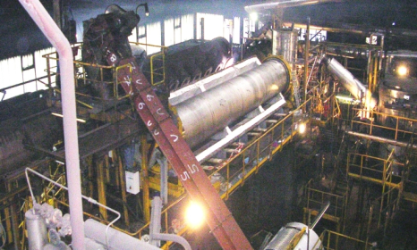
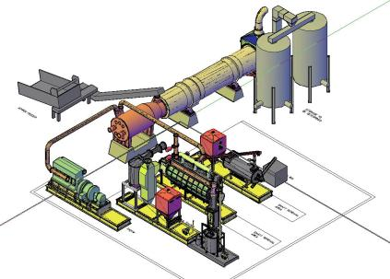
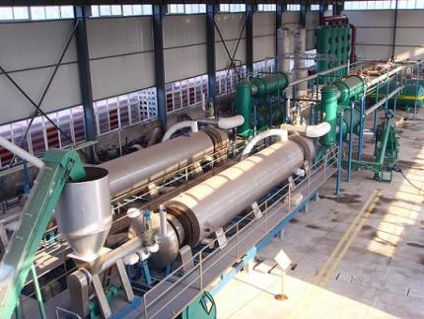
Dynamotive - fast-pyrolysis
Splainex – Waste Pyrolysis
EEA Continuous Flow System - scrap tires
Pacific Pyrolysis

Slide 12

What is ‘pyrolysis’?
electricity
biochar
Slow pyrolysis process

Slide 13
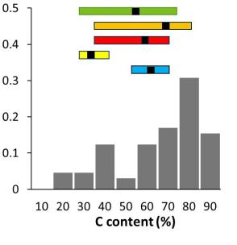
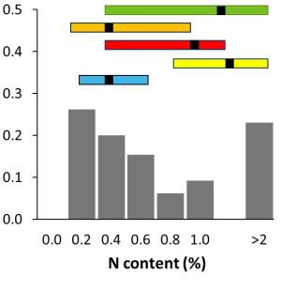
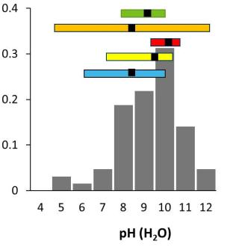
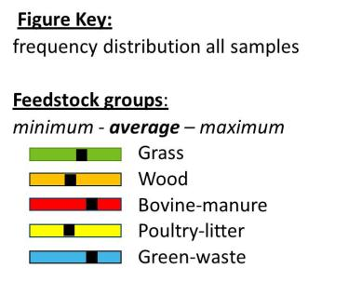
Recalcitrant
National Biochar Initiative: E Krull CSIRO

Slide 14
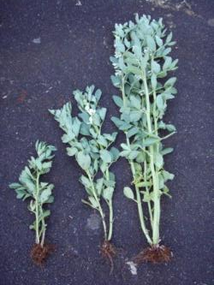
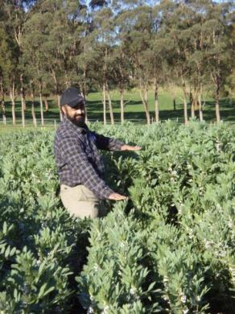
Poultry litter char applied to radish Y. Chan 2007
Paper sludge char applied to wheat
L. Van Zwieten 2007
Lukas Van Zwieten NSW DPI
Notes:
Add Lukas’ trial

Slide 15
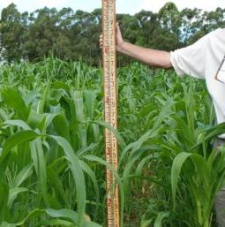
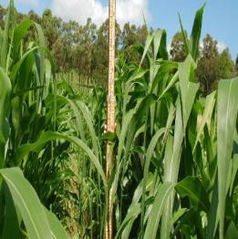
Sustained increase in plant growth
Poultry biochar rate t/ha | Maize 07/08 weight of cobs (t/ha) | Faba bean 2008 dry bean (t/ha) | Maize 08/09 weight of cobs (t/ha)
0 | 16.2 | 2.4 | 19.6
5 | 17.9 | 4.2 | 22.5
10 | 26.7 | 4.6 | 22.6
20 | 28.4 | 5.5 | 22.3
50 | 32.9 | 5.6 | 24.2
1200mm tall
1900mm tall
Source: L. Van Zwieten NSW DPI
Notes:
All treatments minus fertiliser

Slide 16
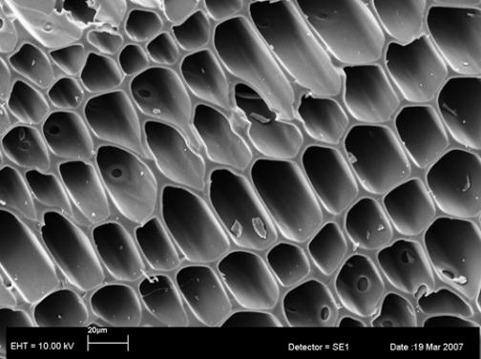
Recalcitrant
Source: S. Joseph UNSW
Source: E Krull CSIRO

Slide 17
Cumulative per cent of biochar-C decomposed
BP Singh et al. 2012 (EST)
0.5% to 8.9% of biochar C mineralized
over 5 years.
.

Slide 18
Biochar stability - a function of feedstock and pyrolysis conditions
BP Singh et al. 2012 (EST)
Synthesis: “after E. Krull”

Slide 19
NMR parameters as predictors of biochar stability
BP Singh et al. 2012 (EST)
Biochar stability strongly, non-linearly, related with the proportion of non-aromatic C and degree of aromatic condensation of biochars.

Slide 20
IBI index of biochar stability
BC₊₁₀₀ – The fraction of carbon present in biochar that is expected to remain in soil for at least 100 years (3) when added to soil
Indicator: H/C_{org}

Slide 21
Biochar can reduce soil N₂O emissions
35000
Alfisol
12000
Vertisol
Control
30000
Poultry manure_400
10000
25000
8000
20000
Wood_550
Cumulative N2O emissions µg /m2
6000
15000
Poultry manure_550
4000
10000
Wood_400
5000
2000
14-73% reduction in N2O
23-52% reduction in N2O
0
0
4-Aug
9-Aug
14-Aug
19-Aug
24-Aug
29-Aug
4-Aug
9-Aug
14-Aug
19-Aug
24-Aug
29-Aug
The day of gas sampling
The day of gas sampling
BP Singh et al. 2010 (JEQ)

Slide 22
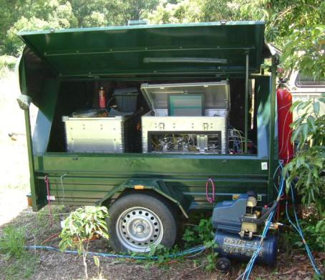
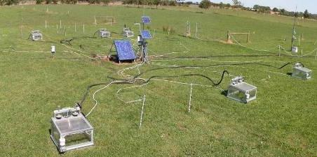
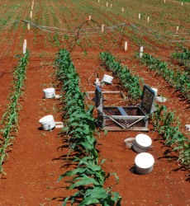
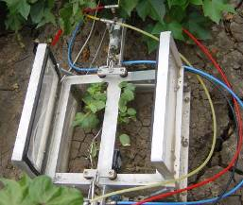
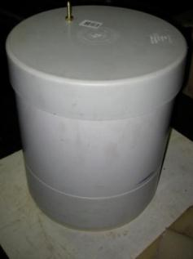
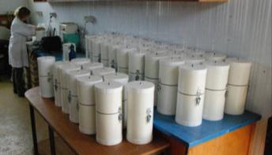
Nitrous oxide measurement

Slide 23
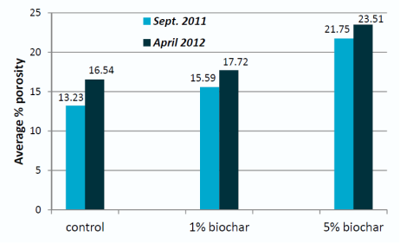
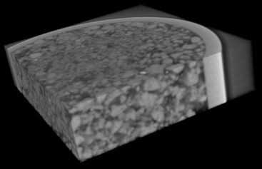
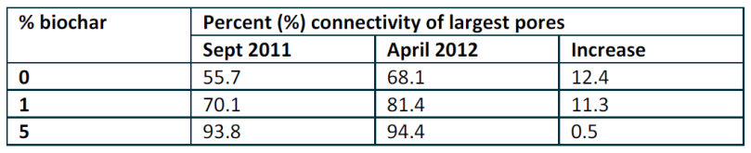
Biochar impact on soil porosity
National Biochar Initiative: Peter Quin et al UNE/NSW DPI

Slide 24
GHG mitigation benefits of biochar
Delayed decomposition of biomass
Reduced nitrous oxide emissions from soil
Increased soil organic matter
Avoided fossil fuel emissions due to use of syngas as renewable energy
Increased plant growth, plant health
Avoided emissions from N fertiliser manufacture
Reduced fuel use in cultivation, irrigation
Avoided methane and nitrous oxide emissions due to avoided decay of residues

Slide 25
Biochar system
Reference system
Biomass residue
Biomass residue
Fossil energy/carbon source
Extraction
Transport
Transport
Transport
Pyrolysis to biochar and syngas
Composting
Conversion to energy carrier
Distribution of compost
Distribution of energy carrier
Distribution of biochar
Distribution of energy carrier
Fertiliser manufacture
Distribution of fertiliser
Soil amendment
Energy service (heat, electricity)
Soil amendment
Energy service (heat, electricity)

Slide 26
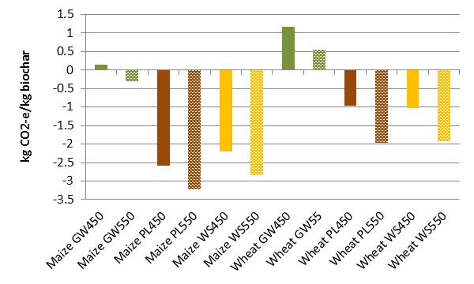
Life cycle GHG emissions
Maize
Wheat

Slide 27
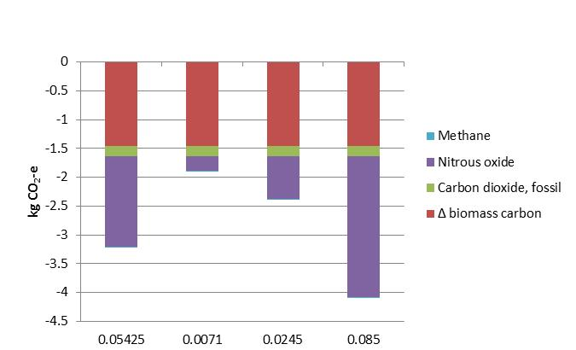
Sensitivity: Nitrous oxide from raw poultry litter
N2O Emissions factor, kg N2O-N/kg N applied; 1 kg PL550 on maize

Slide 28
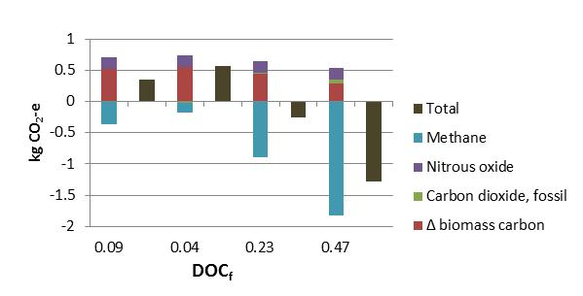
Sensitivity: Decomposition of greenwaste in landfill
1 kg GW550 on maize

Slide 29
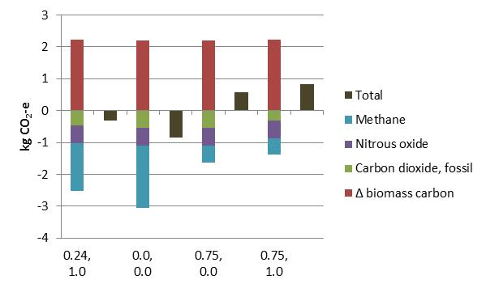
Sensitivity: Methane capture from landfill
Fraction captured; fraction utilized for electricity; 1 kg GW550 on maize

Slide 30
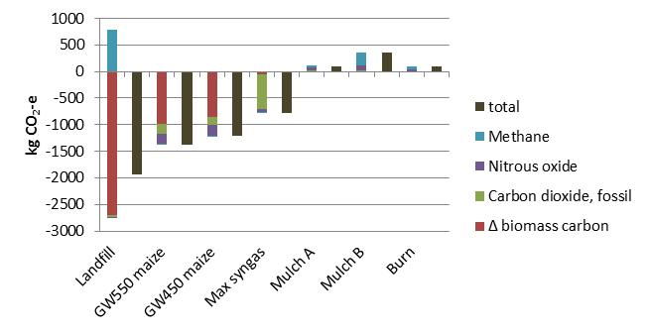
Alternative options for utilisation of 1 t greenwaste

Slide 31
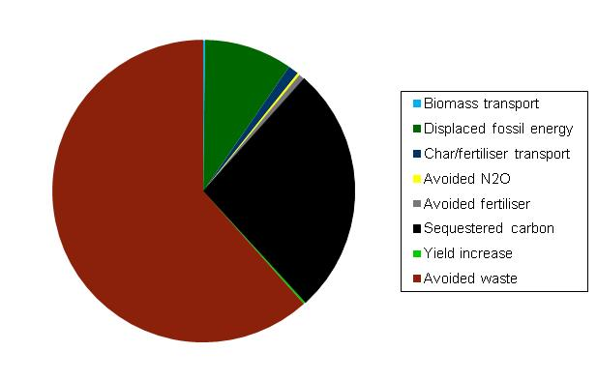
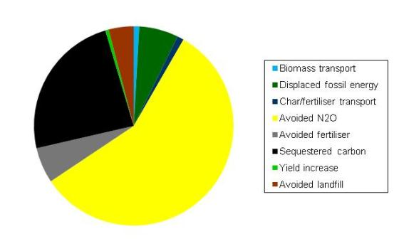
Factors contributing to mitigation
Greenwaste biochar applied to canola
Poultry litter biochar applied to broccoli

Slide 32
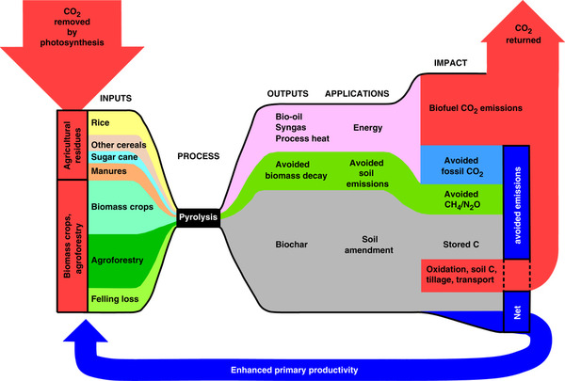
Potential mitigation through biochar - global
Woolf et al 2010 Global technical potential: 6 Gt CO₂-e pa

Slide 33
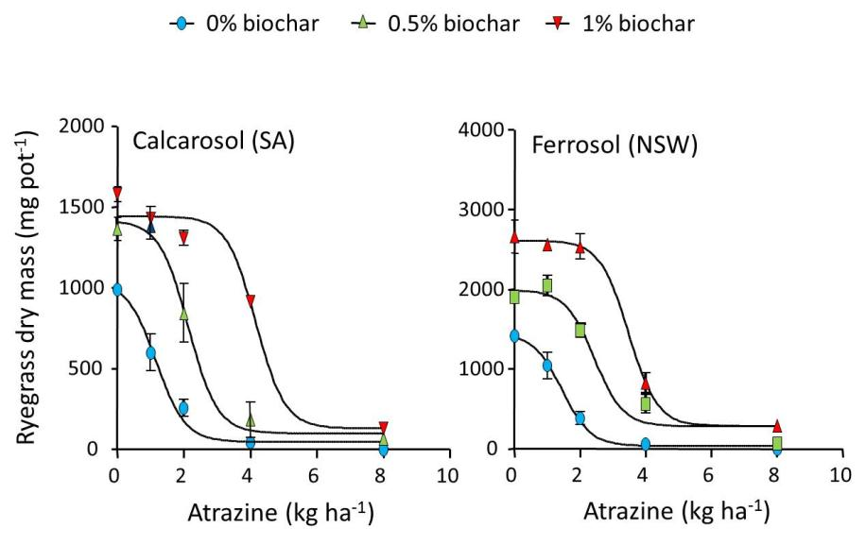
Interactions between herbicide and biochar
National Biochar Initiative, Rai Kookana CSIRO
Notes:
Wheat straw char
Effectiveness of atrazine reduced more that trifluralin (not shown) - trifluralin is less mobile, less contact with biochar
Rate needed inc 2-3 fold - more impact on calcarosol than ferrosol

Slide 34
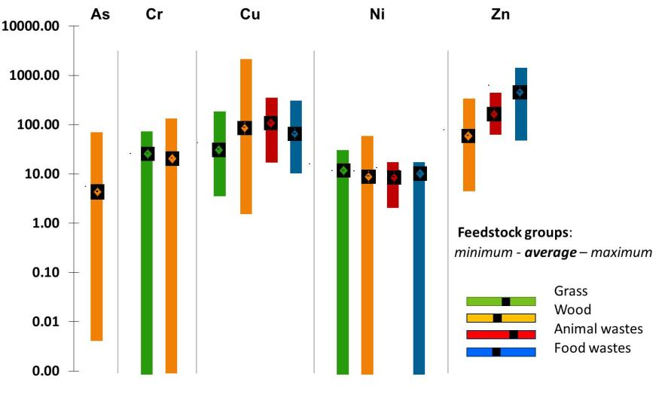
Contamination risk?
National Biochar Initiative, Mark Farrell, CSIRO
Notes:
Risk of contamination
Total conc of heavy metals in 65 biochars
Most elements concentrated 2-5 times cf feedstock
Test of uptake showed low phytoavailability

Slide 35
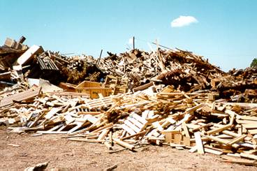
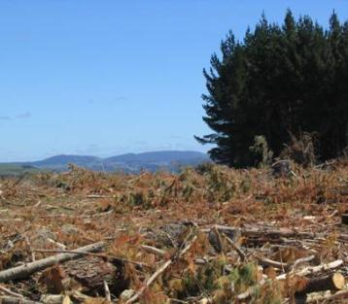
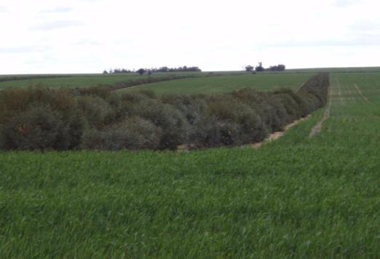
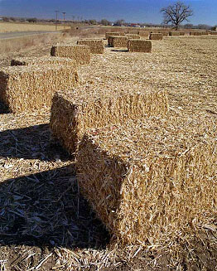
Biomass sources
  Biomass sources:
  Urban green waste
  Manure, biosolids
  Rice husk, bagasse, sugar cane tops
  Sawmill residues
  Forest harvest residues?
  Crop stubble?
  Purpose-grown crops?

Slide 36




fibreboard
habitat
biofuel
biochar
Soil carbon
biochemicals

Slide 37



Sustainability issues for biochar – direct (1)
Biomass procurement
  Residues:
    Soil erosion
    Soil compaction
    Nutrient depletion
    Soil carbon loss (GHG, productivity impact)
  Purpose grown:
    Water use
    Biomass and/or soil carbon decline
    GHG balance - N₂O emissions

Slide 38



Sustainability issues for biochar – direct (2)
Biochar production
  GHG emissions
  particulate emissions
Biochar application
  dust
  contamination (if feedstock contaminated)
Whole system:
  net mitigation benefit (incl transport, plant construction)
  Compared with reference use

Slide 39







What is the best use of biomass resources?

Slide 40
What do we know about biochar?
Biochar can increase plant yield
  But not all plants / all soils
Biochar is resistant to decomposition
  But some biochars are more resistant than others
Biochar can reduce nitrous oxide emissions
  But not from nitrification
Biochar can deliver net greenhouse gas mitigation
  If made appropriately; Other options may give greater mitigation
Biochar could contaminate soil
  But only if made from contaminated feedstock
Some unintended consequences
  Biochar can reduce efficacy of herbicides

Slide 41



To pyrolyse, or not to pyrolyse….
Biosecurity
Odour
Concentration of C and nutrients
Transport costs
Beneficial agricultural reuse?
Renewable energy- electricity, thermal.

Slide 42
A DAFF field trial comparing pyrolysed vs unpyrolysed poultry litter
Productivity
N-use efficiency
Emissions of greenhouse gases
 | Total amendment weight t dry matter /ha | Total C addition t/ha | Total available N addition Units N/ha
Biochar | 10.0 | 4.5 | <1
*Poultry litter | 11.84 | 4.5 | 60
*Urea | 0.252 | <0.1 | 116
*Biochar plus urea | 10 + 0.252 | 4.5 | 116
Biochar plus poultry litter | 10+ 11.84 | 9.0 | 60
nil | 0 | 0 | 0

Slide 43
Basic properties of amendments
 | Unit | Poultry biochar | Raw Poultry litter
Total Carbon | % | 45 | 37
Total Nitrogen | % | 3.3 | 3.1
Total Phosphorus | % | 2.9 | 1.8
Potassium | % | 2.7 | 1.7
pH (CaCl2) | pH units | 8.2 | 6.7
Acid Neutralising Capacity | % CaCO3 equivalent | 5.3 | 5.2
KCl extractable Ammonium-N | mg/kg | 34 | 4,900
KCl extractable Nitrate-N | mg/kg | 4 | 28
Water Soluble Phosphorus | mg/kg | 2,500 | 6,600
Citrate Insoluble Phosphorus | mg/kg | 9,200 | 1,500
Citrate Soluble Phosphorus | mg/kg | 17,000 | 10,000
Available Phosphorus | mg/kg | 20,000 | 17,000

Slide 44
Biochar vs raw poultry litter (PL): impact on corn
Treatment | Corn Yield (t/ha fresh cob) | Total AG Dry matter (t/ha) | Total N uptake (t/ha)
Control | 18.3 | 6.48 | 0.17
Urea | 22.6 | 8.28 | 0.23
PL | 27.5 | 13.1 | 0.32
Biochar | 31.5 | 11.2 | 0.30
Biochar+Urea | 25.0 | 9.30 | 0.24
Biochar+PL | 28.7 | 13.5 | 0.36
lsd | 4.4 | 3.4 | 0.07

Slide 45
Pyrolysing poultry litter to biochar has similar benefits on crop production but results in significantly lower emissions of N₂O
Poultry litter biochar ameliorates a range of constraints- particularly P nutrition, allowing higher N use efficiency
Labile C inputs from raw poultry litter induce (prime) native N mineralisation- higher N₂O and CO₂.
Van Zwieten L, Kimber SW, Morris SG, Singh BP, Grace P, Scheer C, Rust J, Downie A, Cowie A (2013) Pyrolysing poultry litter reduces N2O and CO2 flux. Science of the Total Environment. http://dx.doi.org/10.1016/j.scitotenv.2013.02.054

Slide 46
Economic assessment for poultry litter biochar
Renewable energy
certificates
Carbon value
Electricity value
Biochar
$0.75M
$1M
$6.4M
4t/hr poultry litter
2.3MW/h
38% biochar yield
60% C in biochar
Source: L. Van Zwieten and L Orr I&I NSW

Slide 47
Summary
Biochar can stabilise C for decades to centuries
Biochar may deliver other climate benefits
Biochar may not always be the best use of biomass
Biochar is beneficial when
made from sustainably harvested and renewable biomass resources
produced in a facility that controls emissions and harnesses heat for efficient beneficial use to displace GHG-intensive fuels
applied with care, to responsive soil type / crop
formulated into designer amendments

